Slide 1
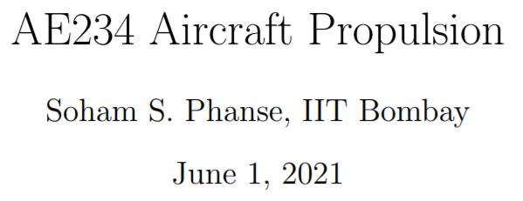

Slide 2
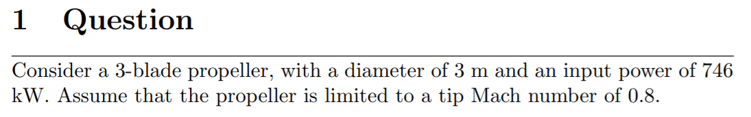



Slide 3
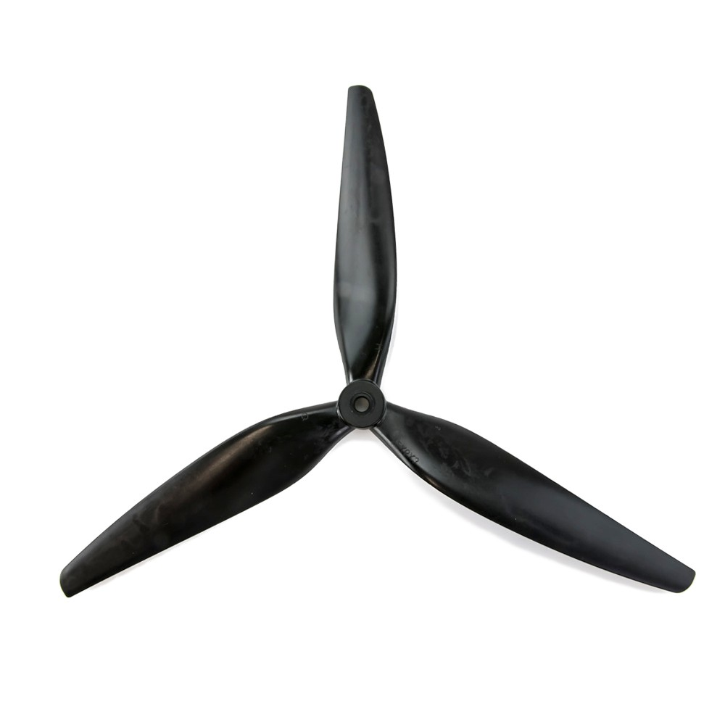
Solution
Let's break it down into parts. Let's get a propellor onboard, then we can go ahead.
And what more do we have?
SSL Conditions
⍴_{air} = 1.225 kg/m3
T_{air} = 288.15 K
M_{tip} <= 0.8
3 m

Slide 4
Solution
As we have M_{tip} <= 0.8. We have the following expressions,
M_{tip} ✖ a_{SSL} = V_{tip} = ω_{propellor} ✖ R_{tip}
a_{SSL} = (𝛾

